Slide 2
Contents
CEO’s Message
About Us
Our Facility
Products
Sizes and Surfaces Finishes
Edge Chamfering
Applications
Packing
Contact Info

Slide 3
CEO’s Message
We appreciate your interest in our company and we are glad to be of help.
NMG is full service quarries and manufacturer of stone products, supplying a variety of products, both standard and customized to ensure a stunning diversity in its marble & granite production.
I want to personally assure you that YOU are our first priority. We at NMG strive to give our customers excellent products and service.
Thank you
Mohamed El Shalakany

Slide 4
About Us
Nefertiti marble and granite was established in Al Minya’s Industrial zone in 2012, with a strong background in the Egyptian industrial market since 1975.
We are a fast growing company that excels in export and trade of marble, granite, slate, sandstone and lime stone.
NMG is in the process of expanding and exporting its products supply to the MENA region, Far East Asia, Europe and the Americas.
We are engaged in a difficult and gratifying business, which involves collecting and providing natural stones for the modern day customer.
We offer variety of services and products and are keen to satisfy the needs of our customers in regards to quality, cost and time. We do our work in an unbroken chain of production entirely within our own facilities.

Slide 5
Our Facility
In production, using the latest technology and machines helps us to introduce the best quality product and services. We have a wide range of marble and natural stones products color and size scale.
Our machinery includes :
Mono and Multi Gang Saw
Block cutter
Polishing and stripping line
Brushing line
Calibrated tile line and cut to size

Slide 6
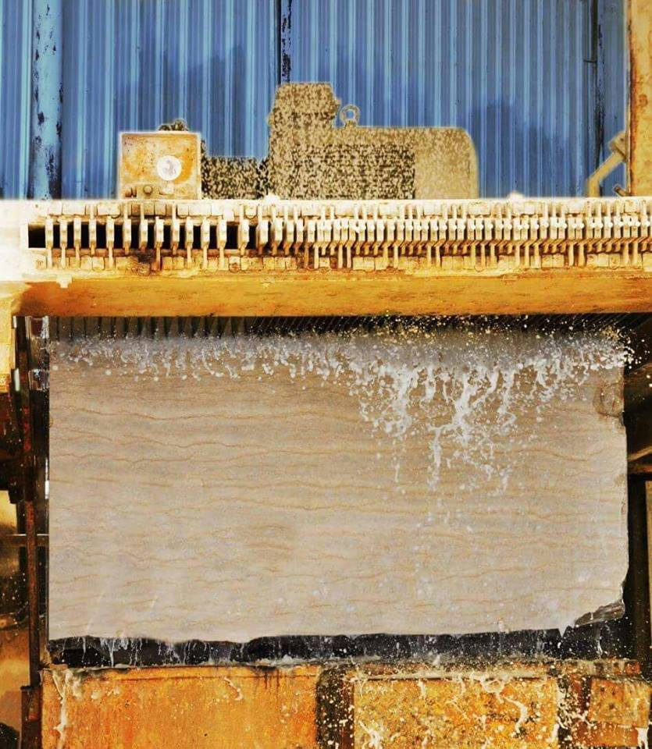

Slide 7
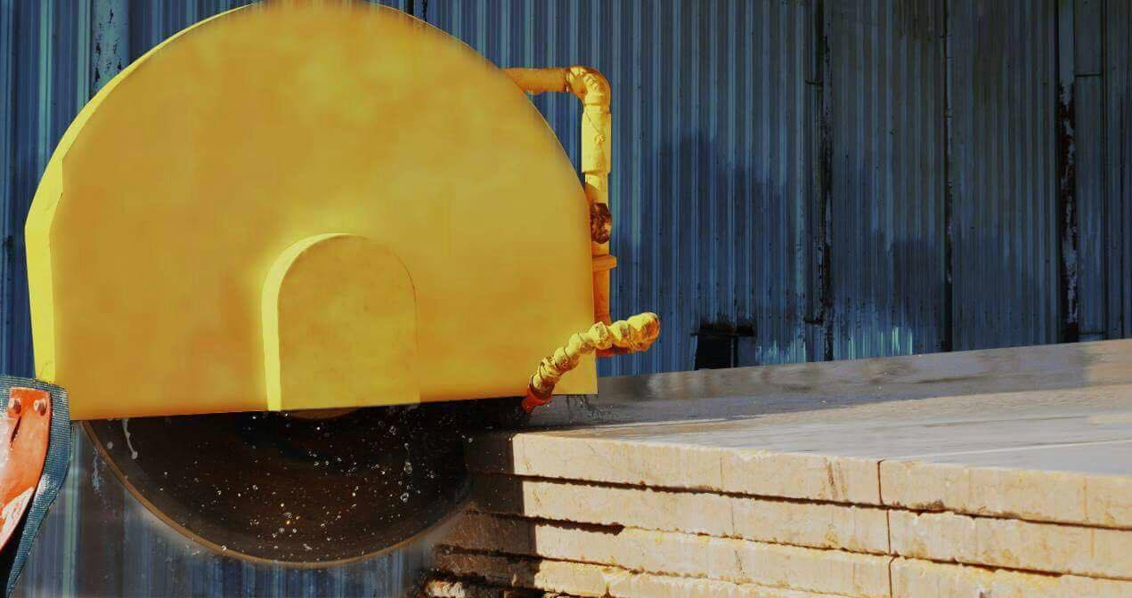

Slide 9
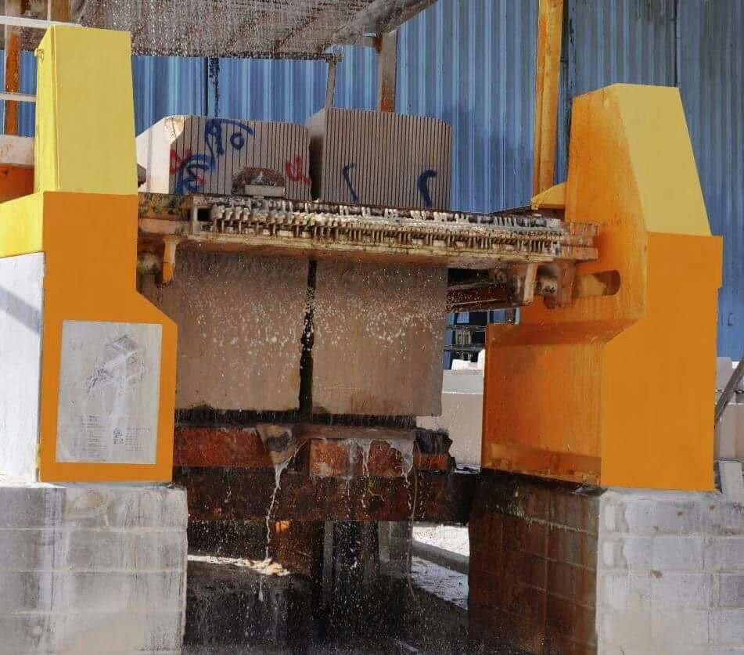

Slide 10
Products
Egyptian Marble
Egyptian Granite

Slide 11
Egyptian Marble Standard Specifications & Technical Data
Water Absorption (ASTM C 97): 0.29 %
Modulus of Rupture (ASTM C 99): 2000 psi
Compressive Strength (ASTM C 170): 13300 psi
Abrasion Resistance (ASTM C 24): 26.4 Ha
Flexural Strength (ASTM C 880): 1600 psi
Density (ASTM C 97): 2618
Country of origin: Egypt
Material availability: Blocks, slabs, tiles
Dimensions of the slabs: 265-300cm x 160-195cm
Thickness of the slabs (Availability): 15-20-30-40-50mm (up to 200mm by order)
Dimensions of the tiles (Availability): Any dimensions
Thickness of the tiles: 10-12-15-20-30-40mm (up to 200mm by order)

Slide 12
SUNNY MINYA CREAMY
SUNNY ROSE

Slide 13
White SILVIA
SILVIA ROSE

Slide 14
GALALA CREAMY
GALALA ROSE

Slide 15
SAMAHA
FELLETTO

Slide 16
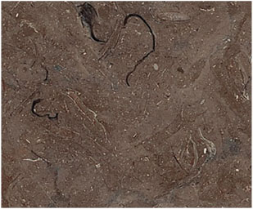
MELLY GRAY
MELLY BROWN

Slide 17
TERIESTA DARK
TERIESTA LIGHT

Slide 18
Egyptian Granite Standard Specifications & Technical Data
Water Absorption (ASTM C 97): 0.08 %
Modulus of Rupture (ASTM C 99): 2 400 psi
Compressive Strength (ASTM C 170): 24 800 psi
Abrasion Resistance (ASTM C 24): 40.6 Ha
Flexural Strength (ASTM C 880): 2 200 psi
Density (ASTM C 97): 2 649
Country of origin: Egypt
Material availability: Blocks, slabs, tiles
Dimensions of the slabs: 180-210cm x 45-65cm
Thickness of the slabs (Availability): 10-12-15-20mm
Dimensions of the tiles (Availability): Any dimensions
Thickness of the tiles: 10-12-15-20 mm

Slide 19
GANDOLA
FORSAN

Slide 20
ROSA HODY
ROSA ASWAN

Slide 21
ROYAL RED EGYPT
RED ASWAN

Slide 22
NERO ASWAN
GREEN VERDI

Slide 23
YELLOW VERDI
BIANCO HALAYEB

Slide 24
HALAYEB
GRAY ASWAN

Slide 25
Sizes and Surfaces Finishes

Slide 26
Available Sizes
Blocks, Slabs (2 Cm, 3 Cm& 4 Cm thickness), Cut to sizes and tiles.

Slide 27
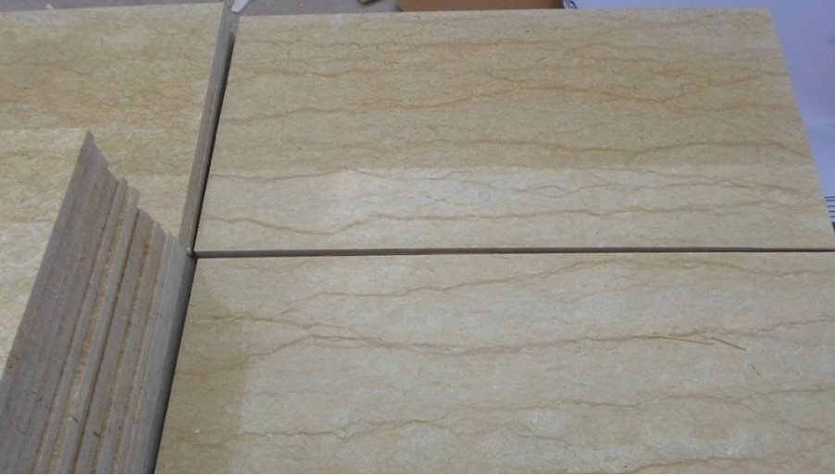
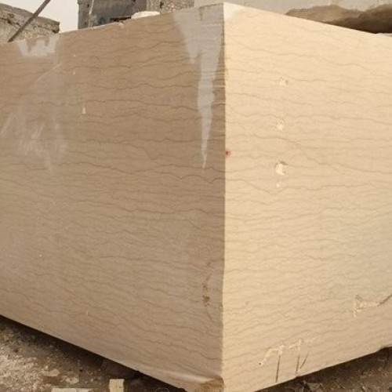
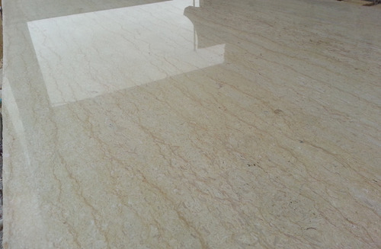

Slide 28
Available Surface Finishes

Slide 29
BUSHHAMMERED
A mechanical round hammering process that produces textured surfaces varying from subtle to rough.
Applications: walls (interior & exterior) & floors (exterior)

Slide 30
TUMBLED
Tumbling is vibrating the tiles with some special stones to give the surface a textured and antique look whereby the edges are rounded and imperfect.
Applications: walls & floors (interior & exterior)

Slide 31
SPLIT FACE
Split face surfaces are those which are left natural after manual splitting of Stone along planar surfaces. This finish shows the actual natural earthy tone of the Stone.
Applications: wall cladding (interior & exterior)

Slide 32
ACID WASHED
Stone surfaces are treated by acids to give them a spectacular antique look.
Applications: walls & floors (interior)

Slide 33
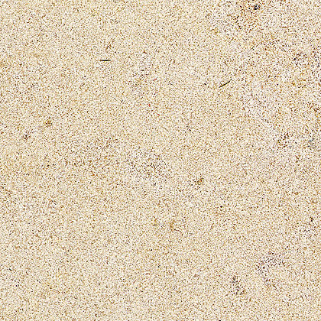
BRUSHED
An antique stone finish produced by continuous scrubbing of the surface with wire brushes.
Applications: walls & floors (interior & exterior)

Slide 34
SAND BLASTED
A high pressure jet of siliceous sand/ or steel shots is applied to the area to be treated. This treatment produces a smooth abrasion, leaving the material with a slightly scratched surface (but not roughed). The color tones and the veins are slightly dulled.
Applications: walls & floors (interior & exterior)

Slide 35
Flamed
Applying blowtorch-strength heat to the surface of Marble & Granite, this actually pops some of the crystals and creates a deeply textured surface which produces flamed Stone. In addition to its rough beauty, flamed Granite has a highly textured surface, which gives it a very non-slippery surface, ideal for exterior installations.
Applications: walls & floors (exterior)

Slide 36
Honed
A sati-smooth Stone finish. Honed finish has a matte or satin finish for a softer, more subdued look, achieved by stopping just short of the last stage of polishing.
Applications: walls & floors (interior & exterior)

Slide 37
Polished
A Shiny, mirror-like finish resulting from filling the pores of the rough saw-cut surface through treating and grinding the surface using some polishing abrasive stones. Marble, Limestone & Granite slabs are polished by large polishing machines, which progressively grind the rough saw-cut surface giving it a spectacular mirror-like finish.
Applications: walls & floors (interior & exterior)

Slide 38
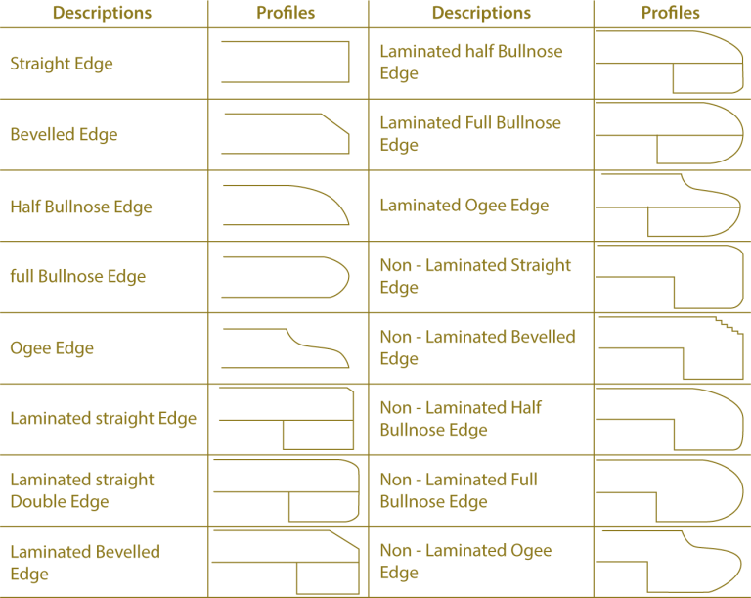
Edge Chamfering

Slide 39
Applications
The amazing range of textures and colors of natural stone, especially marble and granite, and exceptional strength and durability, are all combined to ensure its ongoing popularity as a natural product, delivering high value-for-money, superb appearance and very low maintenance.

Slide 40
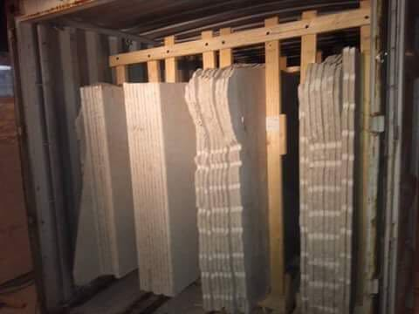
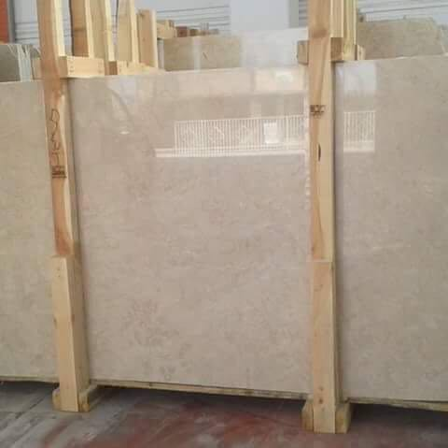
Packing

Slide 41
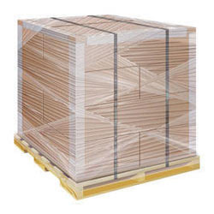
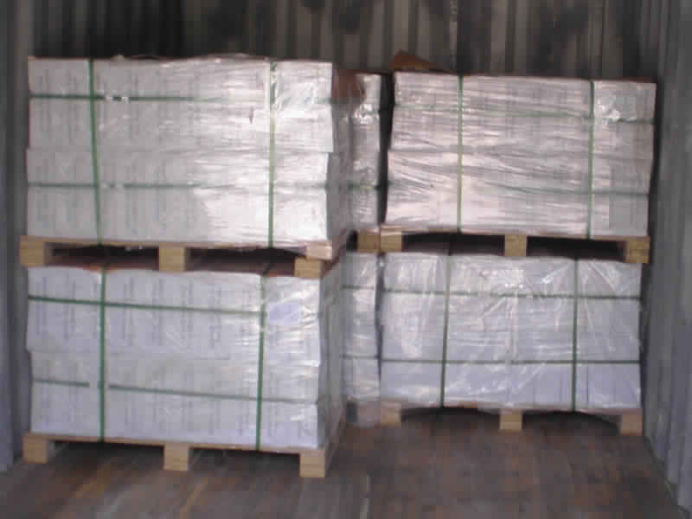
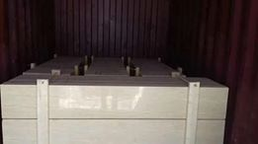
Tiles packing

Slide 42
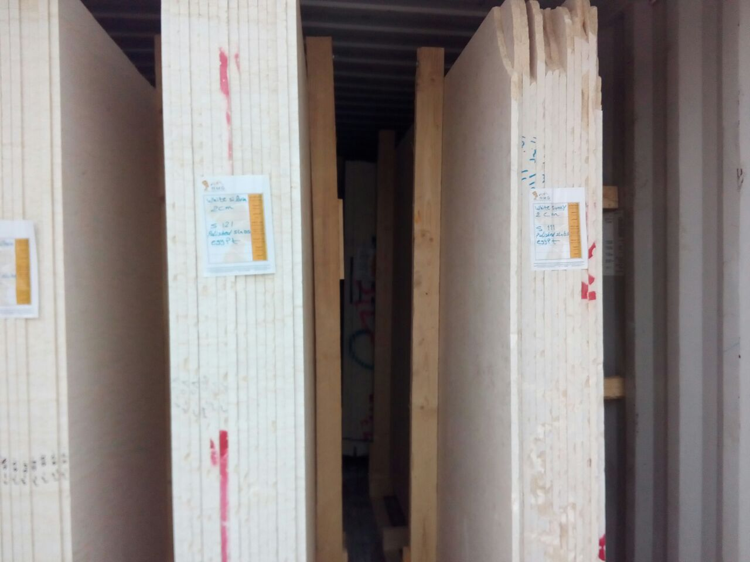
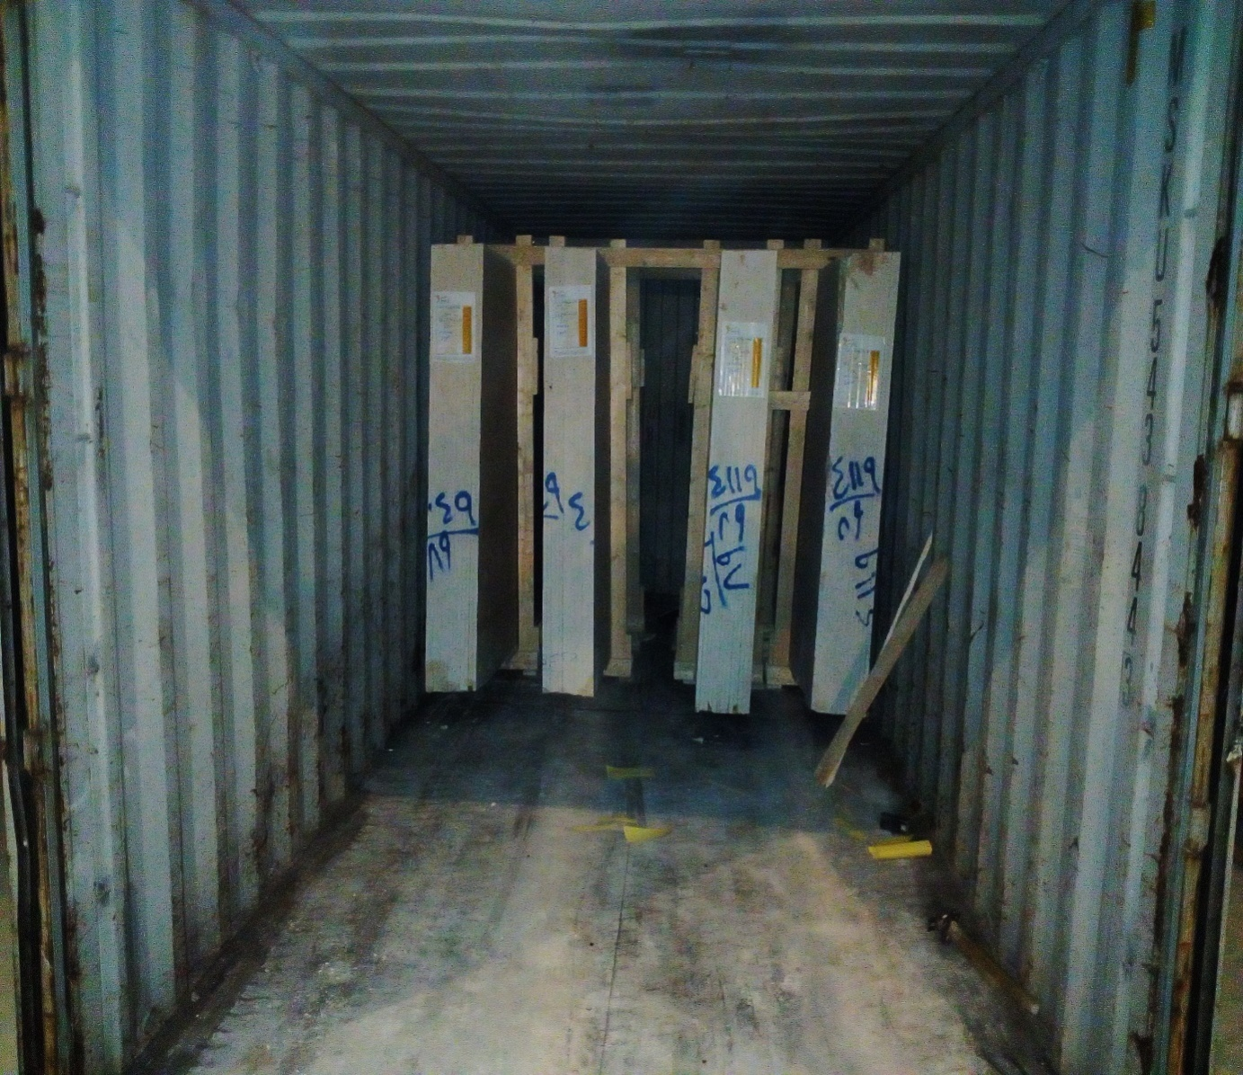
Bundle Packing

Slide 43
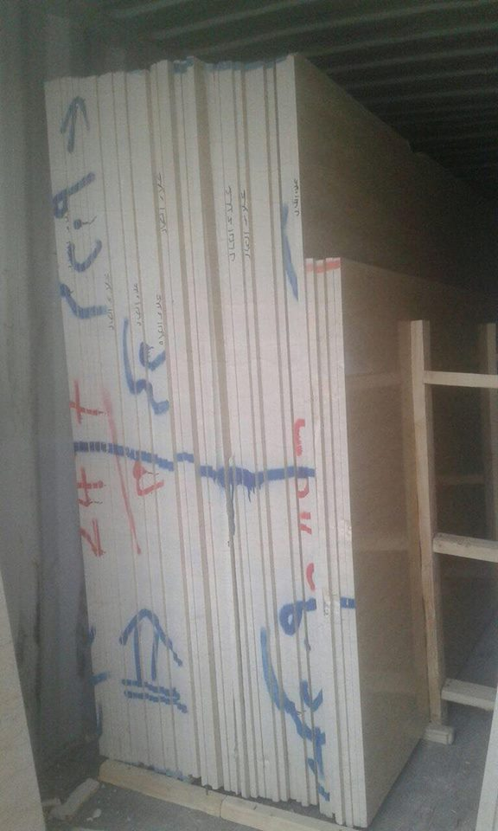
loose loading

Slide 44
Contact Info
Nefertiti marble Head office: 98 Emtedad Al-Amal towers, Autostrade road, Maadi, Cairo, Egypt.
Nefertiti Marble Factory: Minya Industrial area, chemical and building material zone, East Minya, Al Minya city, Egypt.
Email: customerservices@nefertitimarble.com
Land Line: +20 2270114 55
Mobile: +20 1000 9035 15/16
Web: www.nefertitimarble.com
Facebook Page https://www.facebook.com/nefertitiMY/

